Slide 1
Convolutions
Brian Caffo

Slide 2
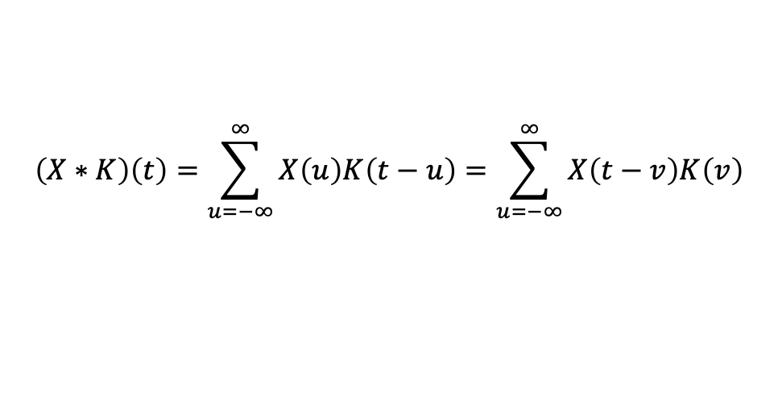
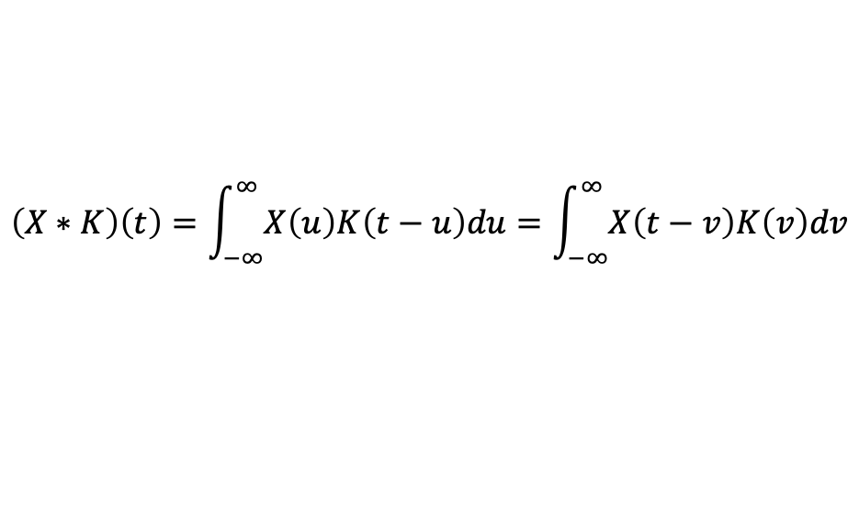
Convolutions
Convolutions are an important topic in mathematics, statistics, signal processing ...
Let's discuss 1D convolutions first
$$\left(X∗K\right)\left(t\right)=\int_{−∞}^{∞}{X\left(u\right)K\left(t−u\right)du}=\int_{−∞}^{∞}{X\left(t−v\right)K\left(v\right)dv}$$
$$\left(X∗K\right)\left(t\right)=\sum_{u=−∞}^{∞}{X\left(u\right)K\left(t−u\right)}=\sum_{u=−∞}^{∞}{X\left(t−v\right)K\left(v\right)}$$

Slide 3
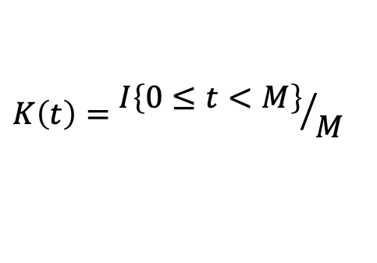
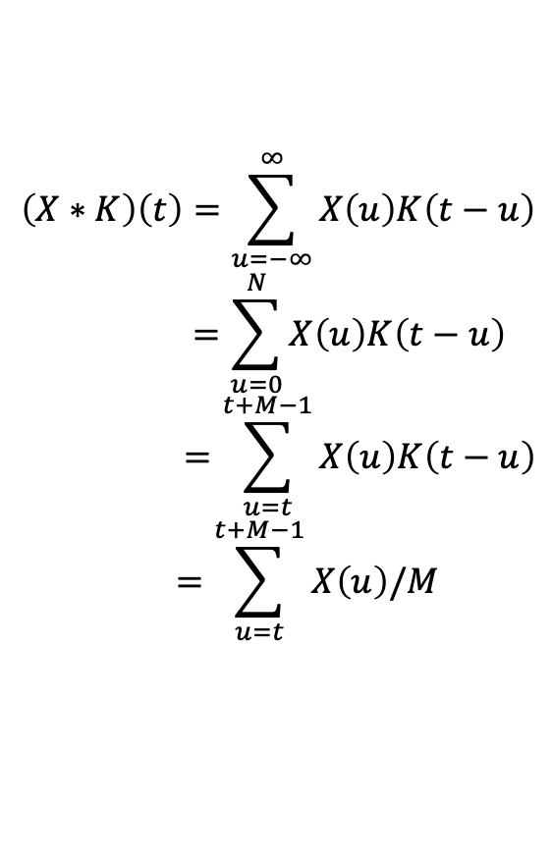
Example, box kernel
$$K\left(t\right)={I\left\{0≤t<M\right\}}/M$$
$$\left(X∗K\right)\left(t\right)=\sum_{u=−∞}^{∞}{X\left(u\right)K\left(t−u\right)} \\ =\sum_{u=0}^{N}{X\left(u\right)K\left(t−u\right)} \\ =\sum_{u=t}^{t+M−1}{X\left(u\right)K\left(t−u\right)} \\ =\sum_{u=t}^{t+M−1}{X\left(u\right)/M}$$

Slide 4
Discussion
When our kernel is a box, convolution results in a moving average
Convolution results in an n+m+1 number of points
Have to zero pad and choice of how to zero pad changes the alignment of the convolution result and the original data
Numpy’s “mode” argument handles this for us

Slide 5
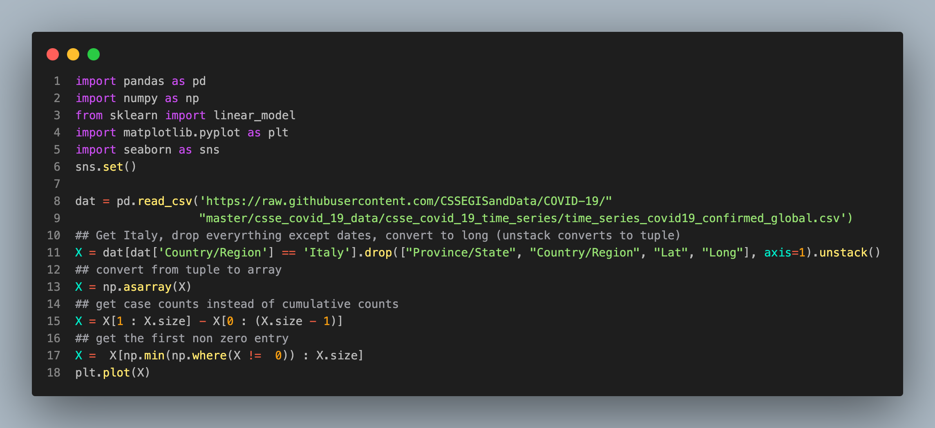
Example, Italy covid data

Slide 6
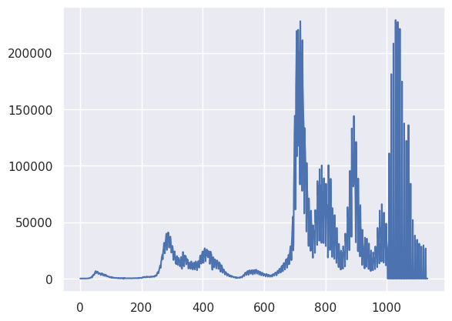

Slide 7
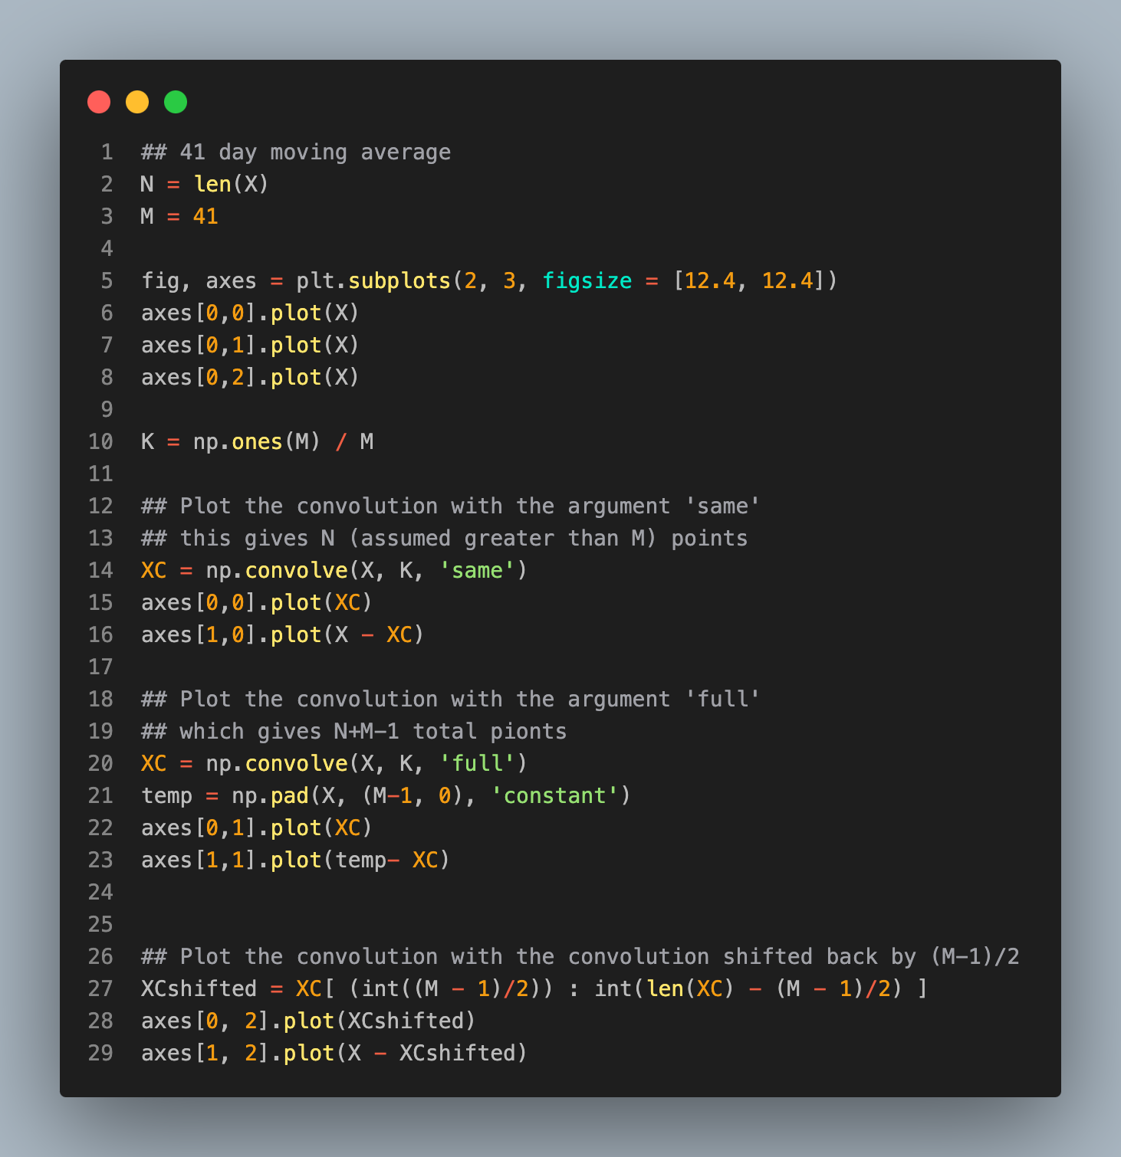
Example convolution

Slide 8
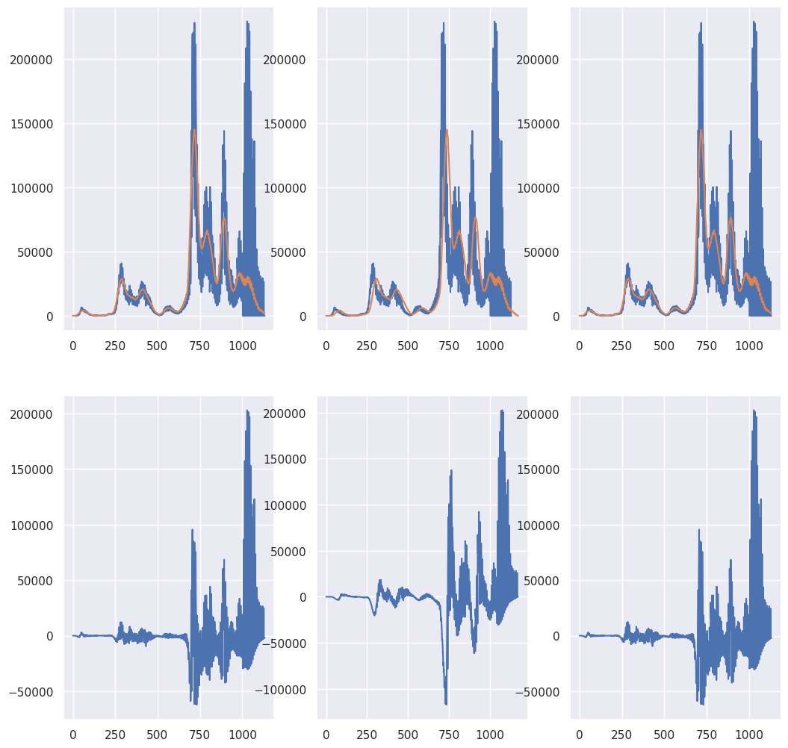

Slide 9
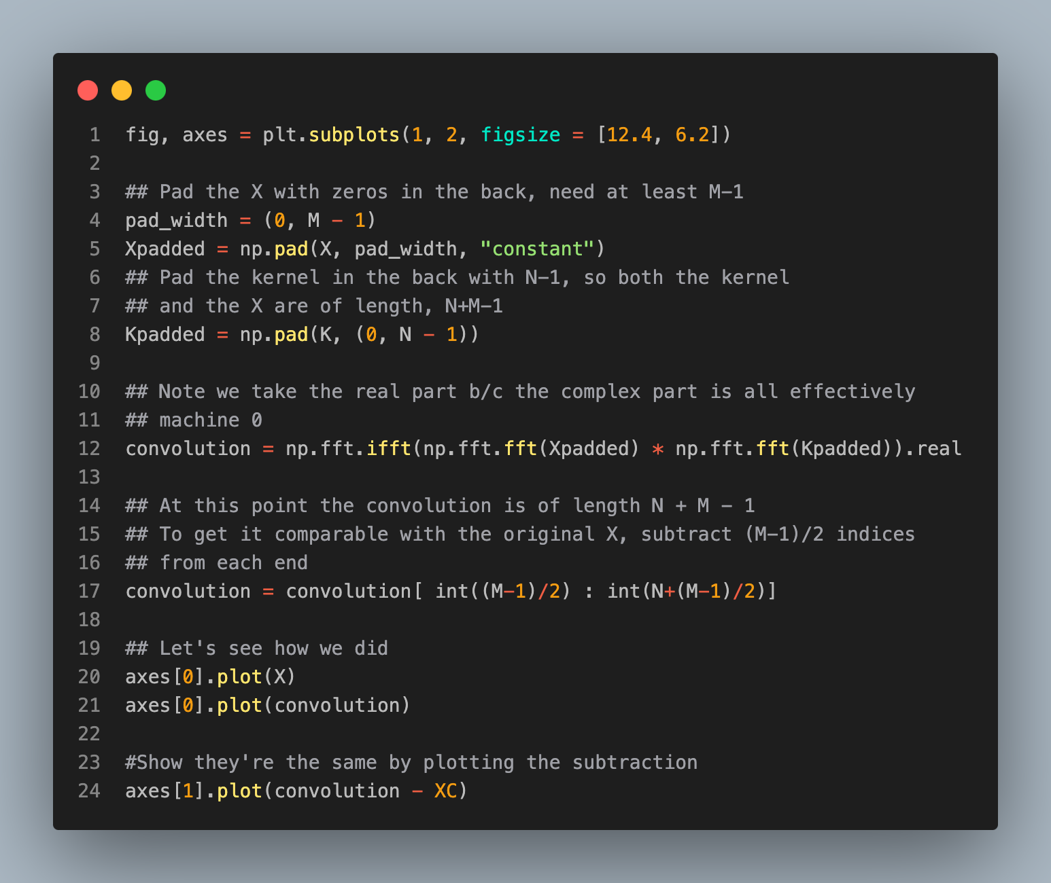

Slide 10
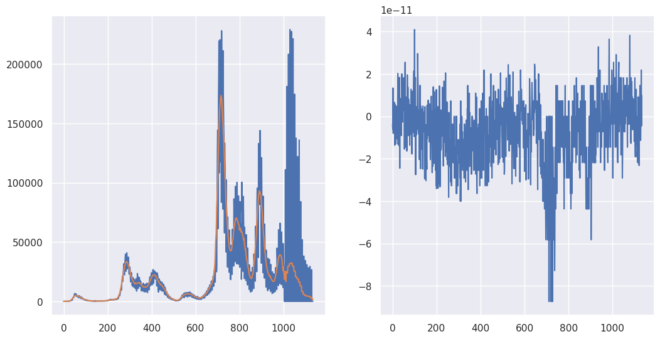

Slide 11
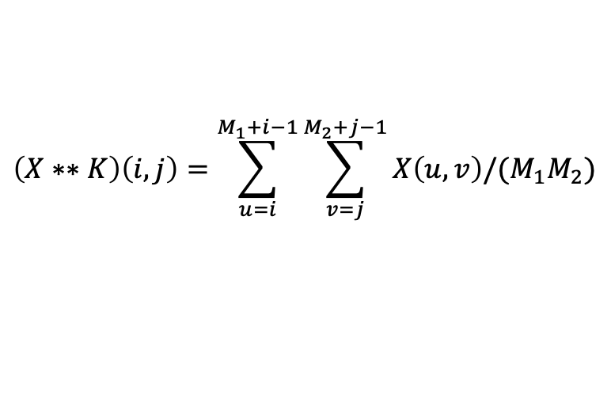
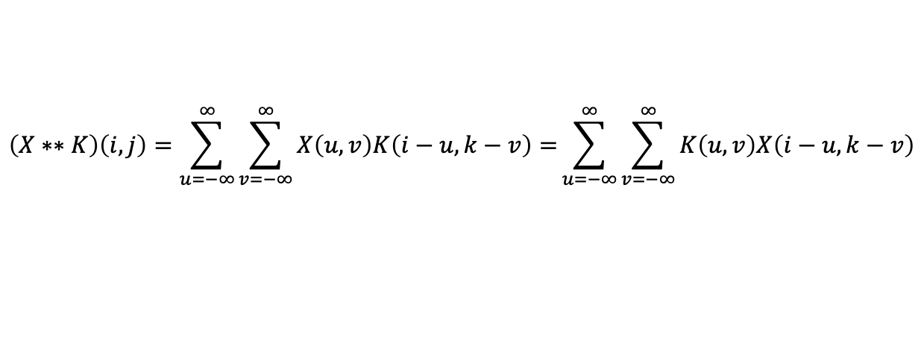
2D convolutions
$$\left(X∗∗K\right)\left(i,j\right)=\sum_{u=−∞}^{∞}{\sum_{v=−∞}^{∞}{X\left(u,v\right)K\left(i−u,k−v\right)=}}\sum_{u=−∞}^{∞}{\sum_{v=−∞}^{∞}{K\left(u,v\right)X\left(i−u,k−v\right)}}$$
Example, box kernel
$$K\left(u,v\right)=I(0≤u<M_{1}, 0≤v<M_{2})/(M_{1}M_{2})$$
$$\left(X∗∗K\right)\left(i,j\right)=\sum_{u=i}^{M_{1}+i−1}{\sum_{v=j}^{M_{2}+j−1}{X\left(u,v\right)/{(M}_{1}M_{2})}}$$

Slide 12

Convolving an image (see code in the book)

Slide 13
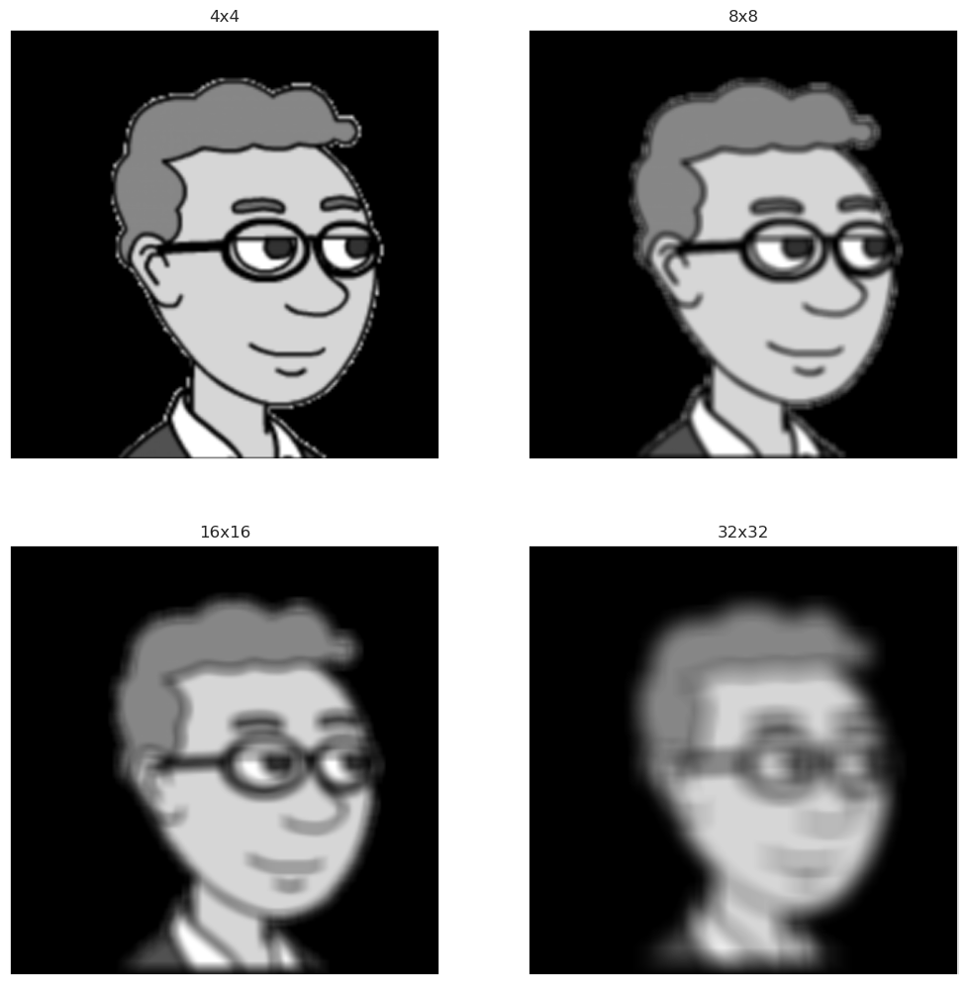

Slide 14
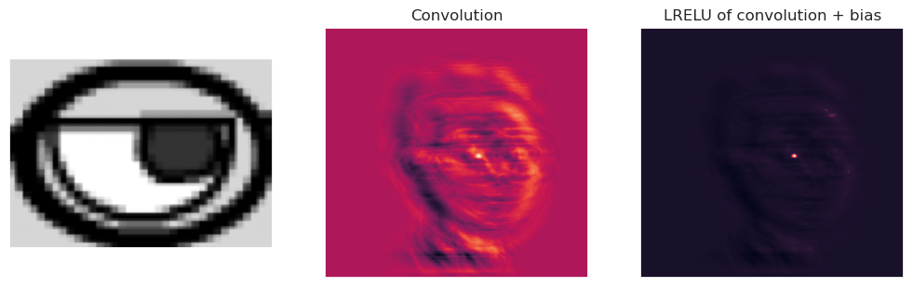
Convolutions and NNs (see code in the book)

Slide 15
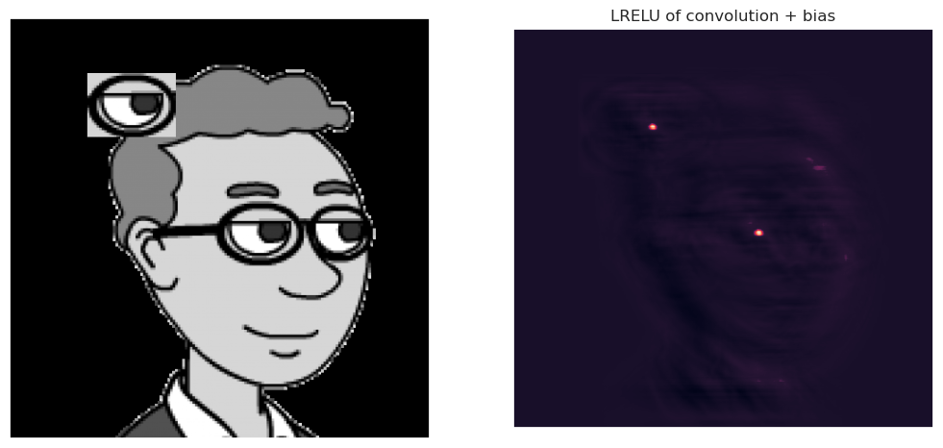
Translation invariance

